Slide 1


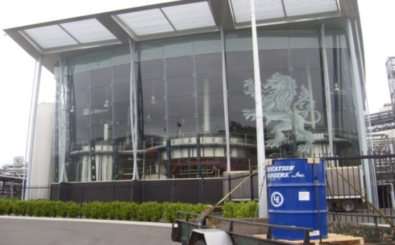
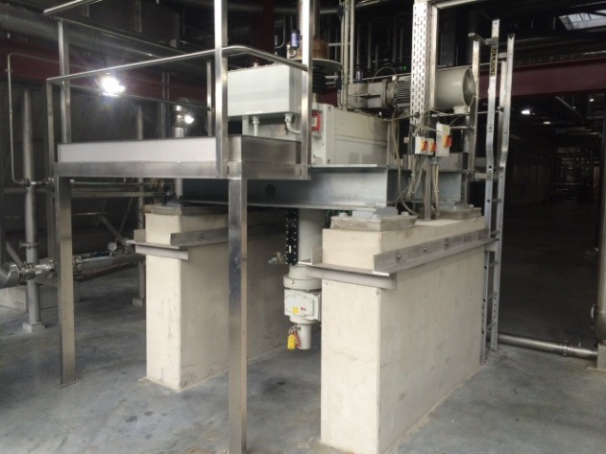

The Lubrication Reliability Source™
Case Study
Lion Breweries The Pride - Lauter Tun Secondary Gearbox
Duolec® Industrial Gear Oil LE1605
Duolec protects one of a kind gearbox
Saving $18,518.00 of oil costs - 10 oil changes
Saving on Labour, Maintenance & Downtime
Reduced environmental impact by eliminating 2,350 Litres of waste oil disposal
Nature of business:
Lion Breweries is New Zealand’s largest alcohol beverage company. Their focus is on the production, marketing, sales and distribution of beer, wine, spirits, cider and RTD products, as well as a range of non-alcohol beverages.
Application:
Lauter Tun Gearbox – Lauter Tuns are used in breweries to separate mash from wort. A raking machine inside the tun rakes grist and malt or removes the spent grains, depending on the direction of rotation.
The height of the raking machine can be varied either electrically or hydraulically according to the process, the height can even be altered under load.
The Flender H3LV gear unit, consists of 3 gearboxes, Primary, Secondary and Rake Lift gear units.
Challenge:
The OEM warranty fill of 235 Litres in the Secondary gearbox of Shell Omala was run to 5,000 hours, the second fill of Shell Omala was monitored by Oil Analysis by LE, results showed excessive wear metals and additive depletion and the decision was made to drain it after 2,500 hours and refilled with Duolec Industrial Gear Oil LE1605 ISO220.

Slide 2
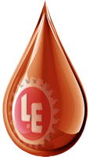
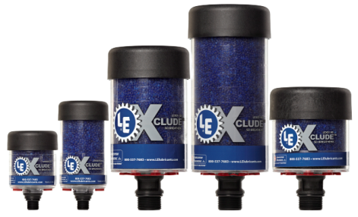
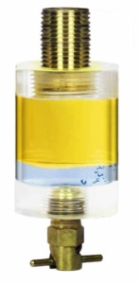
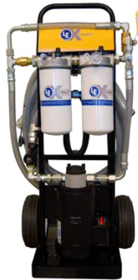
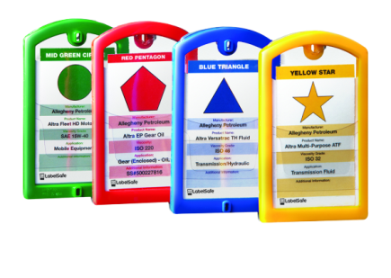
The Lubrication Reliability Source™
LE Solution:
Duolec® LE1605 Industrial Gear Oil, a high performance gear oil acceptable for use in any
industrial gear or bearing application that requires a high thermal stability, extreme pressure lubricant. Duolec® LE1605 is fortified with a shear stable tackifier that promotes adhesion to metal surfaces during use. Regular oil sampling and implementing a reliability program was also recommended.
The combination of Xclude breathers, Xtract Oil Sight Glasses, Duolec Industrial gear oil, regular Oil Analysis sampling and Xtract filtering when required is a simple solution to achieve long-lasting asset protection.
Results:
Lion Breweries changed to Duolec® LE1605 in 2011 and the oil has not been changed in 8 years, 27,000 working hours, a recent Oil Analysis report had come back with an ISO4406 Cleanliness code of 16/14/11.
In addition to these benefits, LE advises that the users of LE lubricants who have documented power consumption on various pieces of equipment have generally seen a 5 to 20 percent reduction in power requirements. The average documented savings using LE lubricants in gearboxes is 15 percent. Unfortunately, prior to installing Duolec® LE1605 in this gearbox, the power consumption was not documented, so it is not possible to show this plant’s energy savings.
“The most important factor for me was that the Duolec stopped the component wear as it is a one of kind gearbox and any new
components would need to be manufactured.
David O’Carroll – Brewery Engineer
Thank you to David O’Carroll for his assistance with this report and to Lion Breweries for the companies long standing relationship with Lubrication Engineers NZ Ltd since 1980.

